Slide 1
Python

Slide 2
range
The range function specifies a range of integers:
range(start, stop) - the integers between start (inclusive) and stop (exclusive)
It can also accept a third value specifying the change between values.
range(start, stop, step) - the integers between start (inclusive) and stop (exclusive) by step
Example:
>>> range(5)
[0, 1, 2, 3, 4]
>>> range(5, 10)
[5, 6, 7, 8, 9]
>>> range(0, 10, 2)
[0, 2, 4, 6, 8]
Example:
for x in range(5, 0, -1):
print x
print "Blastoff!"
Output:
5
4
3
2
1
Blastoff!

Slide 3
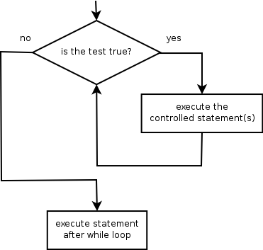
while
while loop: Executes a group of statements as long as a condition is True.
good for indefinite loops (repeat an unknown number of times)
Syntax:
while condition:
statements
Example:
number = 1
while number < 200:
print number,
number = number * 2
Output:
1 2 4 8 16 32 64 128

Slide 4
The for loop
for loop: Repeats a set of statements over a group of values.
Syntax:
for variableName in groupOfValues:
statements
We indent the statements to be repeated with tabs or spaces.
variableName gives a name to each value, so you can refer to it in the statements.
groupOfValues can be a range of integers, specified with the range function.
Example:
for x in range(1, 6):
print x, "squared is", x * x
Output:
1 squared is 1
2 squared is 4
3 squared is 9
4 squared is 16
5 squared is 25

Slide 5
Example 1.
x = int(raw_input("Please enter #:"))
if x < 0:
x = 0
print 'Negative changed to zero'
elif x == 0:
print 'Zero'
elif x == 1:
print 'Single'
else:
print 'More'
Example 2.
if (ben <= 5 and chen >= 10 or chen == 500 and ben != 5):
print “Ben and Chen“
Example 3
if (3 <= Time <= 5):
print “Office Hour"

Slide 6
Break, continue
for value in [3, 1, 4, 1, 5, 9, 2]:
... print "Checking", value
... if value > 8:
... print "Exiting for loop"
... break
... elif value < 3:
... print "Ignoring"
... continue
... print "The square is", value**2
Use “break” to stop
the for loop
Use “continue” to stop
processing the current item

Slide 7
Functions
A function is some stored code that we use. A function takes some input and produces an output.
There are two kinds of functions in Python.
Built-in functions that are provided as part of Python - raw_input(), type(), float(), int() ...
Functions that we define ourselves and then use
We treat the of the built-in function names as "new" reserved words (i.e. we avoid them as variable names)
We define a function using the def reserved word
We call/invoke the function by using the function name, parenthesis and arguments in an expression

Slide 8
Built in function
type()
float()
int()
enumerate()

Slide 9
Building our Own Functions
We create a new function using the def keyword followed by optional parameters in parenthesis.
We indent the body of the function
This defines the function but does not execute the body of the function
def fib(n):
"""Print a Fibonacci series up to n."""
a, b = 0, 1
while b < n:
print b,
a, b = b, a + b
>>> fib(2000)
First line is docstring
first look for variables in local, then global
need global to assign global variables

Slide 10
last arguments can be given as keywords
def parrot(voltage, state='a stiff', action='voom', type='Norwegian blue'):
#!/usr/bin/python
# Function definition is here
def changeme( mylist ):
"This changes a passed list into this function"
mylist.append([1,2,3,4]);
print "Values inside the function: ", mylist
return
# Now you can call changeme function
mylist = [10,20,30];
changeme( mylist );
print "Values outside the function: ", mylist

Slide 11
To function or not to function...
Organize your code into “paragraphs” - capture a complete thought and “name it”
Don’t repeat yourself - make it work once and then reuse it
If something gets too long or complex, break up logical chunks and put those chunks in functions
Make a library of common stuff that you do over and over - perhaps share this with your friends...

